Slide 1

Power system stability

Slide 2
Transient Stability-Equal Area Criterion
The transient stability studies involve the determination of whether or not synchronism is maintained after the machine has been subjected to severe disturbance. This may be sudden application of load, loss of generation, loss of large load, or a fault on the system. A method known as the equal area criterion can be used for a quick prediction of stability. This method is based on the graphical interpretation of the energy stored in the rotating mass as an aid to determine if the machine maintains its stability after a disturbance. This method is only applicable to a one-machine system connected to an infinite bus or a two-machine system. Because it provides physical insight to the dynamic behavior of the machine

Slide 3
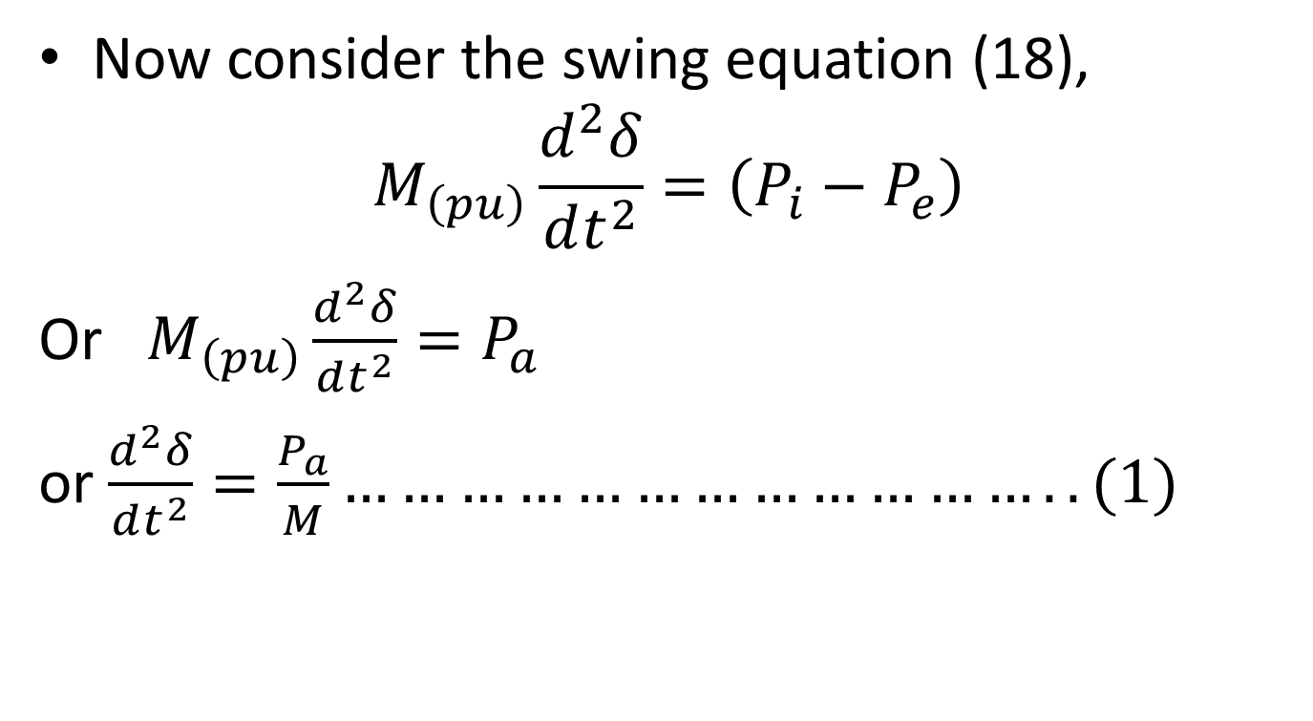
Now consider the swing equation (18),
$$M_{\left(pu\right)}\frac{d^{2}δ}{dt^{2}}=\left(P_{i}−P_{e}\right)$$
Or $M_{\left(pu\right)}\frac{d^{2}δ}{dt^{2}}=P_{a}$
or $\frac{d^{2}δ}{dt^{2}}=\frac{P_{a}}{M}………………………………..(1)$

Slide 4
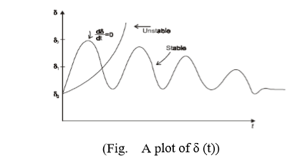
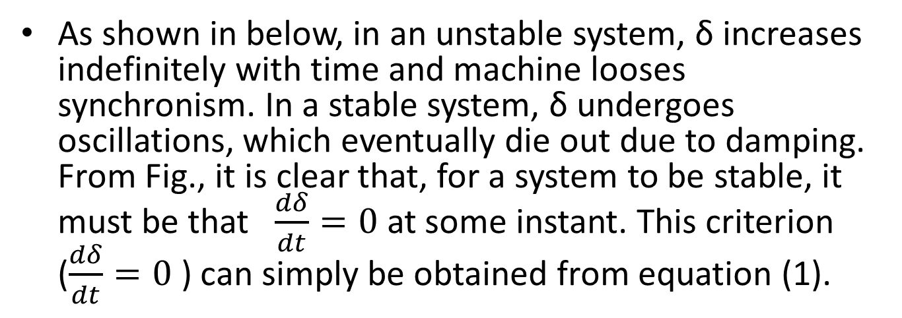
As shown in below, in an unstable system, δ increases indefinitely with time and machine looses synchronism. In a stable system, δ undergoes oscillations, which eventually die out due to damping. From Fig., it is clear that, for a system to be stable, it must be that $\frac{dδ}{dt}=0$ at some instant. This criterion ($\frac{dδ}{dt}=0$ ) can simply be obtained from equation (1).

Slide 5
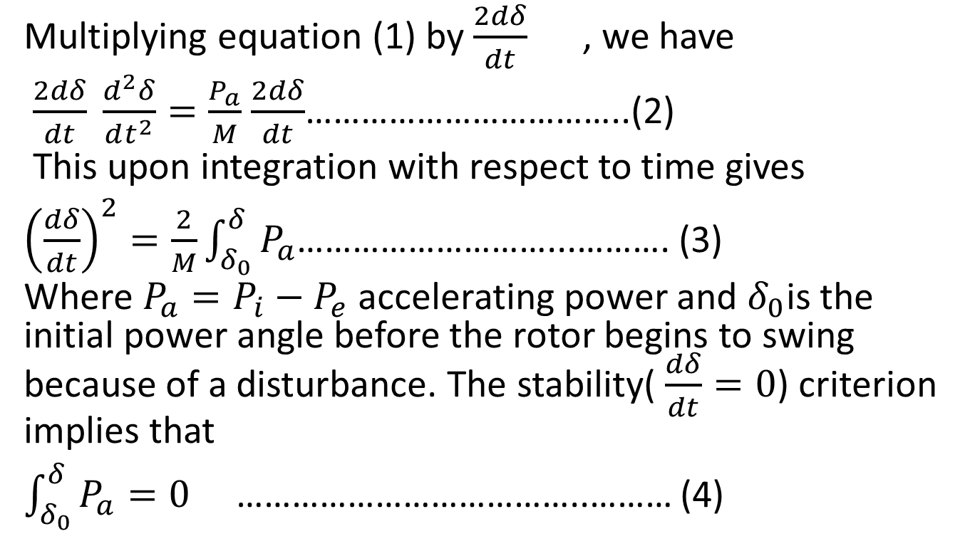
Multiplying equation (1) by $\frac{2dδ}{dt}$ , we have
$\frac{2dδ}{dt} \frac{d^{2}δ}{dt^{2}}=\frac{P_{a}}{M}$ $\frac{2dδ}{dt}$……………………………..(2)
This upon integration with respect to time gives
${\left(\frac{dδ}{dt}\right)}^{2}=\frac{2}{M}\int_{δ_{0}}^{δ}{P_{a}}$………………………...………. (3)
Where $P_{a}=P_{i}−P_{e}$ accelerating power and $δ_{0}$is the initial power angle before the rotor begins to swing because of a disturbance. The stability( $\frac{dδ}{dt}=0$) criterion implies that
$\int_{δ_{0}}^{δ}{P_{a}}=0$ ………………………………..……… (4)

Slide 6
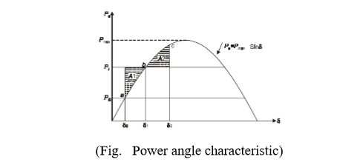
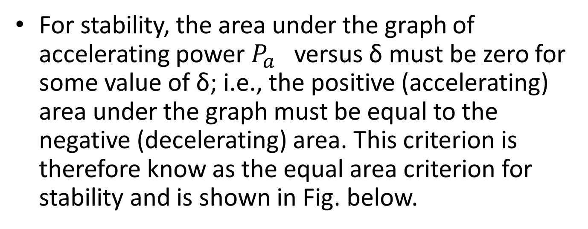
For stability, the area under the graph of accelerating power $P_{a}$ versus δ must be zero for some value of δ; i.e., the positive (accelerating) area under the graph must be equal to the negative (decelerating) area. This criterion is therefore know as the equal area criterion for stability and is shown in Fig. below.

Slide 7
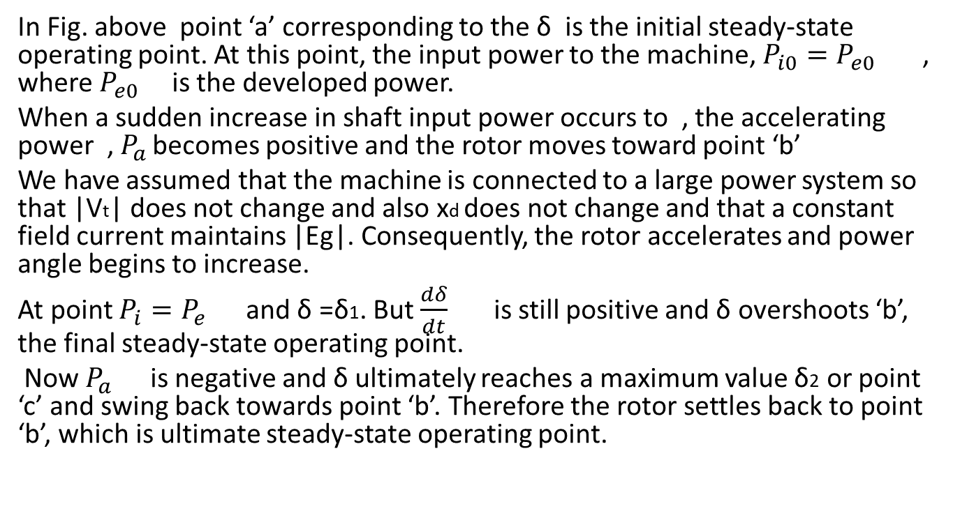
Application to sudden change in power input:-
In Fig. above point ‘a’ corresponding to the δ is the initial steady-state operating point. At this point, the input power to the machine, $P_{i0}=P_{e0}$ , where $P_{e0}$ is the developed power.
When a sudden increase in shaft input power occurs to , the accelerating power , $P_{a }$becomes positive and the rotor moves toward point ‘b’
We have assumed that the machine is connected to a large power system so that |Vt| does not change and also xd does not change and that a constant field current maintains |Eg|. Consequently, the rotor accelerates and power angle begins to increase.
At point $P_{i}=P_{e}$ and δ =δ1. But $\frac{dδ}{dt}$ is still positive and δ overshoots ‘b’, the final steady-state operating point.
Now $P_{a }$ is negative and δ ultimately reaches a maximum value δ2 or point ‘c’ and swing back towards point ‘b’. Therefore the rotor settles back to point ‘b’, which is ultimate steady-state operating point.

Slide 8
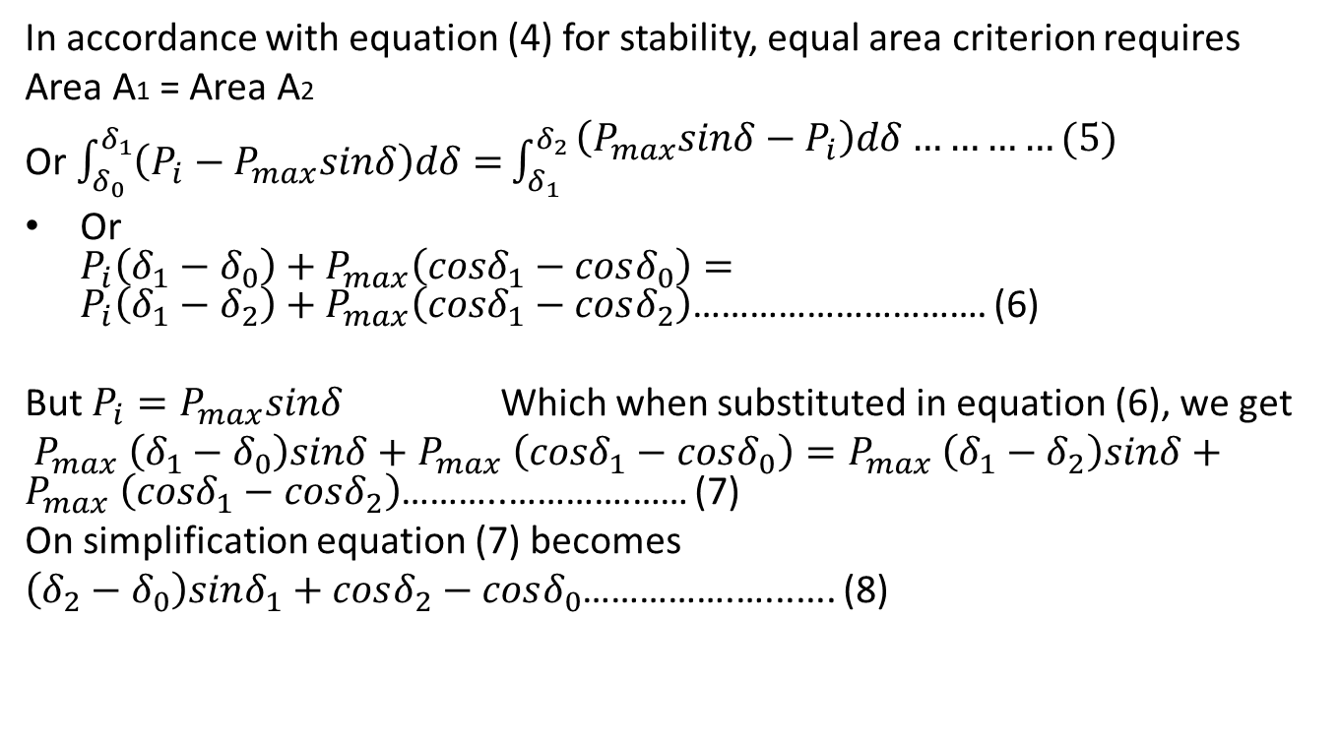
In accordance with equation (4) for stability, equal area criterion requires
Area A1 = Area A2
Or $\int_{δ_{0}}^{δ_{1}}{\left(P_{i}−P_{max}sinδ\right)dδ=}\int_{δ_{1}}^{δ_{2}}{\begin{aligned}\left(P_{max}sinδ−P_{i}\right)dδ…………(5) \\ \end{aligned}}$
Or $P_{i}\left(δ_{1}−δ_{0}\right)+P_{max}\left({cosδ}_{1}−cosδ_{0}\right)=P_{i}\left(δ_{1}−δ_{2}\right)+P_{max}\left({cosδ}_{1}−cosδ_{2}\right)$…………………………. (6)
But $P_{i}=P_{max}sinδ$ Which when substituted in equation (6), we get
$P_{max} \left(δ_{1}−δ_{0}\right)sinδ+P_{max} \left(cosδ_{1}−cosδ_{0}\right)=P_{max} \left(δ_{1}−δ_{2}\right)sinδ+P_{max} \left(cosδ_{1}−cosδ_{2}\right)$………..………….…… (7)
On simplification equation (7) becomes
$\left(δ_{2}−δ_{0}\right)sinδ_{1}+cosδ_{2}−cosδ_{0}$…………….…....... (8)

Slide 9
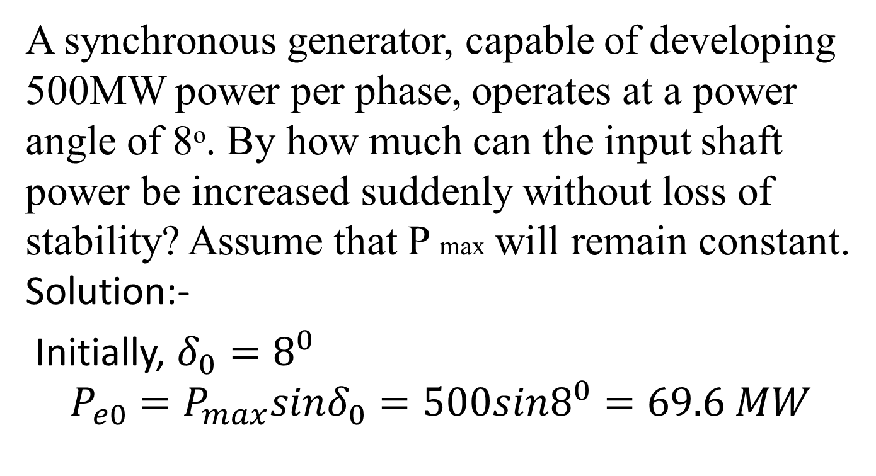
Example 1
A synchronous generator, capable of developing 500MW power per phase, operates at a power angle of 8ᵒ. By how much can the input shaft power be increased suddenly without loss of stability? Assume that P max will remain constant. Solution:-
Initially, $δ_{0}=8^{0}$
$$P_{e0}=P_{max}sinδ_{0}=500sin8^{0}=69.6 MW$$

Slide 10
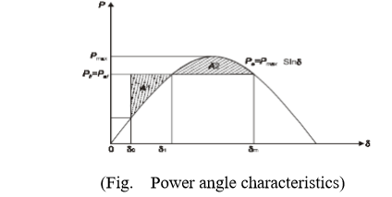
Let δm be the power angle to which the rotor can swing before losing synchronism. If this angle is exceeded, Pi will again become greater than Pe and the rotor will once again be accelerated and synchronism will be lost as shown in Fig. below. Therefore, the equal area criterion requires that equation (6) be satisfied with δm replacing δ2.

Slide 11
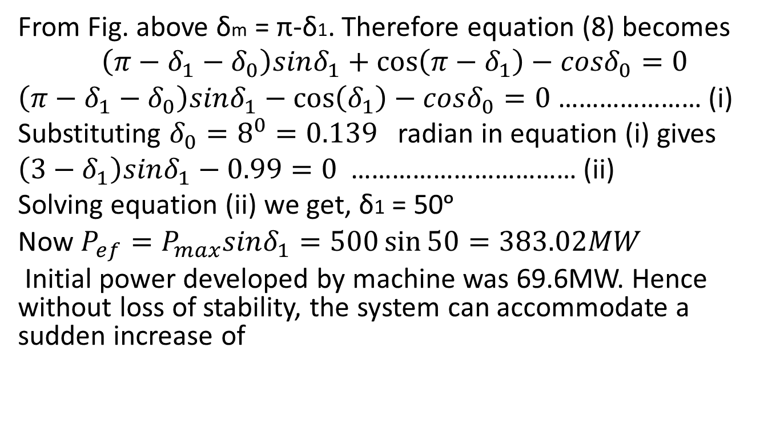
From Fig. above δm = π-δ1. Therefore equation (8) becomes
$$\left(π−δ_{1}−δ_{0}\right)sinδ_{1}+\cos\left(π−δ_{1}\right)−cosδ_{0}=0$$
$\left(π−δ_{1}−δ_{0}\right)sinδ_{1}−\cos\left(δ_{1}\right)−cosδ_{0}=0$ ………………… (i)
Substituting $δ_{0}=8^{0}=0.139$ radian in equation (i) gives
$\left(3−δ_{1}\right)sinδ_{1}−0.99=0$ …………………………… (ii)
Solving equation (ii) we get, δ1 = 50ᵒ
Now $P_{ef}=P_{max}sinδ_{1}=500\sin{50=383.02MW}$
Initial power developed by machine was 69.6MW. Hence without loss of stability, the system can accommodate a sudden increase of

Slide 12
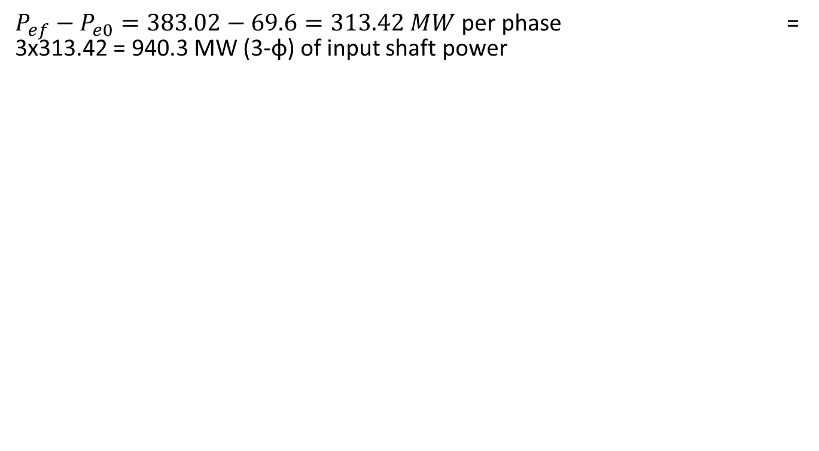
$P_{ef}−P_{e0}=383.02−69.6=313.42 MW$ per phase = 3x313.42 = 940.3 MW (3-φ) of input shaft power

Slide 13
Thank You

